Slide 1


Quantification of the sensitivity of NASA CMS-Flux inversions to uncertainty in atmospheric transport
Thomas Lauvaux, NASA JPL
Martha Butler, Kenneth Davis, The Pennsylvania State University
Kevin Bowman, Junjie Liu, NASA JPL

Slide 2
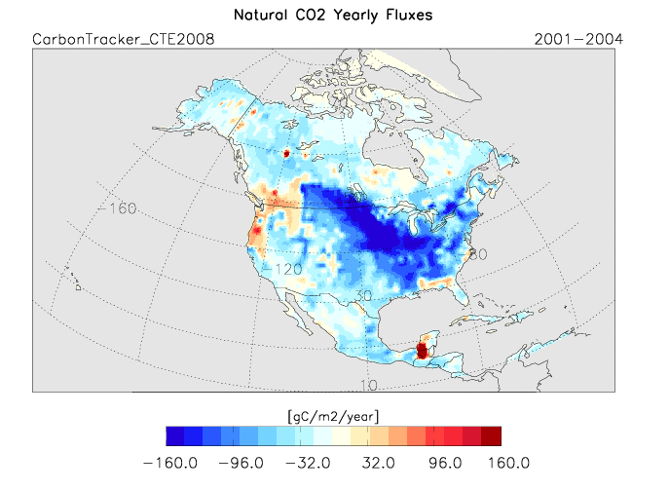
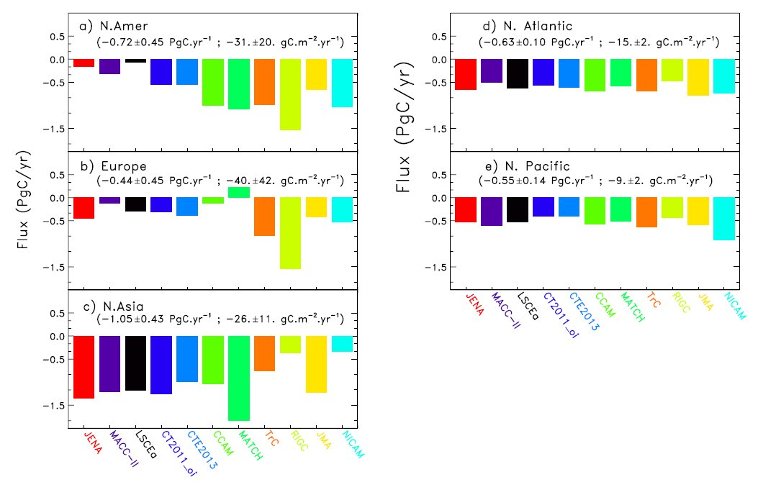
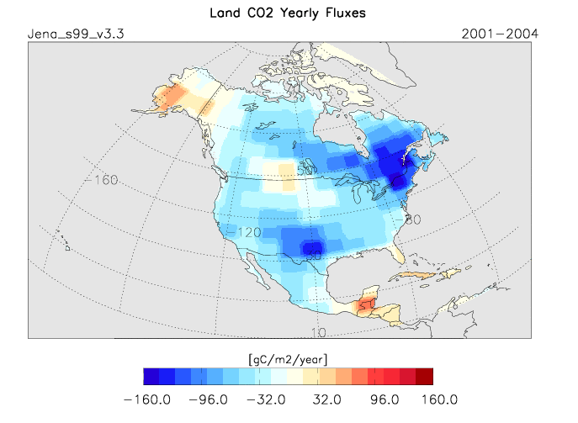
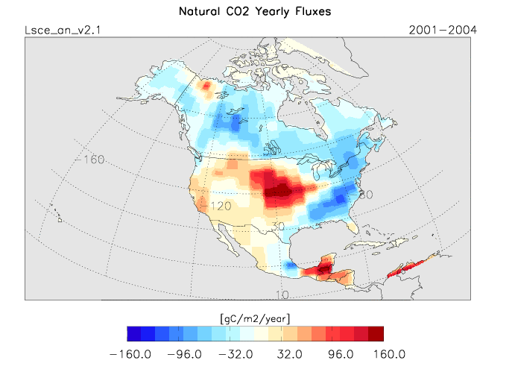
Atmospheric inversion model inter-comparison
from Peylin et al. (2013)
Comparison of posterior CO2 fluxes from 11 global inversions
of the Global Carbon Project for 5 Transcom ecoregions,
in PgC/year.
Natural flux component, annual mean (averaged over 2001-2004), from 3 different inversion systems (ecoregions and pixel-based)
CarboScope (ICOS program, European Commission)

Slide 3
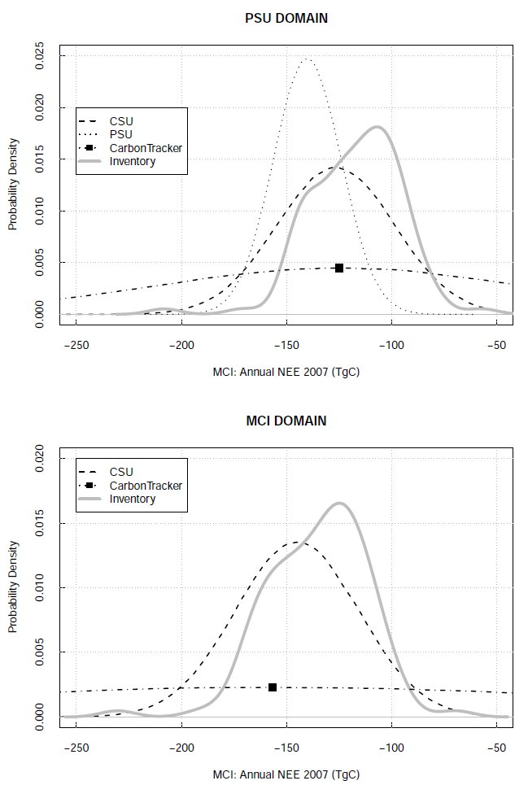
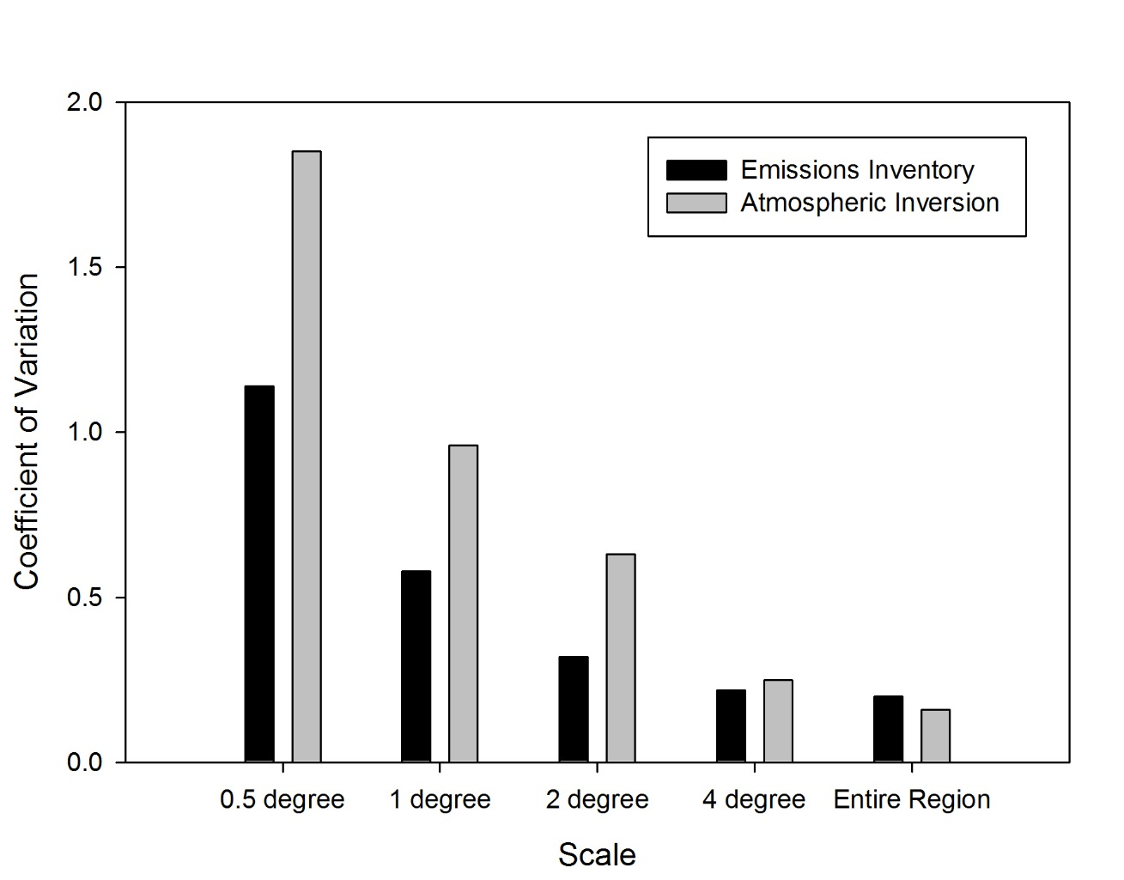
Transport model errors and spatial scales
Coefficient of variation between the inventory and the inverse fluxes from 0.5 degree resolution to the entire domain
Mean estimates for the three inverse estimates and the inventory with their associated posterior uncertainties in TgC
from Ogle et al., sub.
from Schuh et al. (2013)

Slide 4
Project summary: main objectives
Objective 1: Assess the transport error in the global NASA CMS-Flux system and the mesoscale WRF-LPDM based upon meteorological data and CO2 profiles from airborne measurements over North America.
Objective 2: Represent transport error by a physics-based ensemble of transport configurations in WRF.
Objective 3: Estimate the contribution of transport uncertainty over North America to global flux uncertainty.

Slide 5
Project summary: sub-objectives
Objective 1:
NASA CMS-Flux system coupled offline to the mesoscale WRF (WRF-CMS)
Performed 1-year simulation at 30km resolution
Extraction of GOSAT column pseudo-data
Collect meteorological data and CO2 aircraft flask samples
Compare GEOS-CMS and WRF-CMS performances
Objective 2:
Perform ensemble simulations with WRF-CMS over North America
Explore calibration techniques
Sample GOSAT column pseudo-data for the ensemble
Perform GEOS-CMS inversions with WRF-GOSAT pseudo-data
Objective 3:
Assessment of transport uncertainty on global flux uncertainty
Identify sources of errors (i.e. convection, PBL schemes,…)

Slide 6
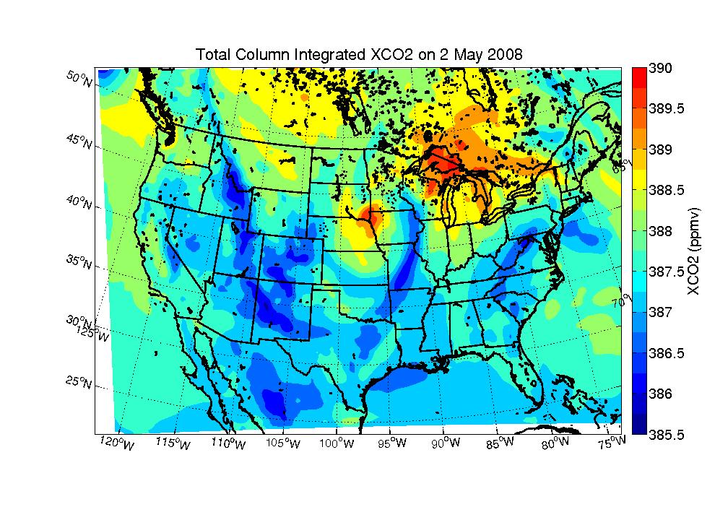
Mesoscale modeling over North America
The PennState Mesoscale system (WRF-CMS):
Weather Research and Forecasting (WRF) model version 3.6 modified for multiple passive tracers (Lauvaux et al., 2012)
30km resolution domain over North America using:
Mellor-Yamada-Nakanishi-Niino 2.5 (PBL scheme)
NOAH scheme (Land surface model)
Single-Moment 5-class scheme (Microphysics scheme)
Kain-Fritsch scheme (Cumulus scheme)
Individual tracers for each CMS Flux
component:
- Biogenic (prior daily, prior monthly, posterior)
- Ocean
- Fire
- Ship
- fossil fuel
Simulated column-integrated dry air mole fraction of CO2 at 7:00 am EST (b) on 2 May 2008 using the WRF system at 30km resolution

Slide 7
NASA CMS-Flux inversion system
NASA CMS-Flux inversion system (Liu et al., 2012)
Produce monthly inverse fluxes at 4°x5° globally using GOSAT data
Newly implemented nested mode over North America: GEOS-Chem 4°x5° with GEOS-Chem NA-nested (0.5°x0.6°)
Combination of surface in-situ CO2 measurements (using Obspack by NOAA-ESRL)
Simulated CO2 concentrations (in ppm) near the surface on 20 January 2010 at 4°x5° resolution (left panel) and GEOS-Chem NA-nested at 0.5°x0.6° (right panel)

Slide 8
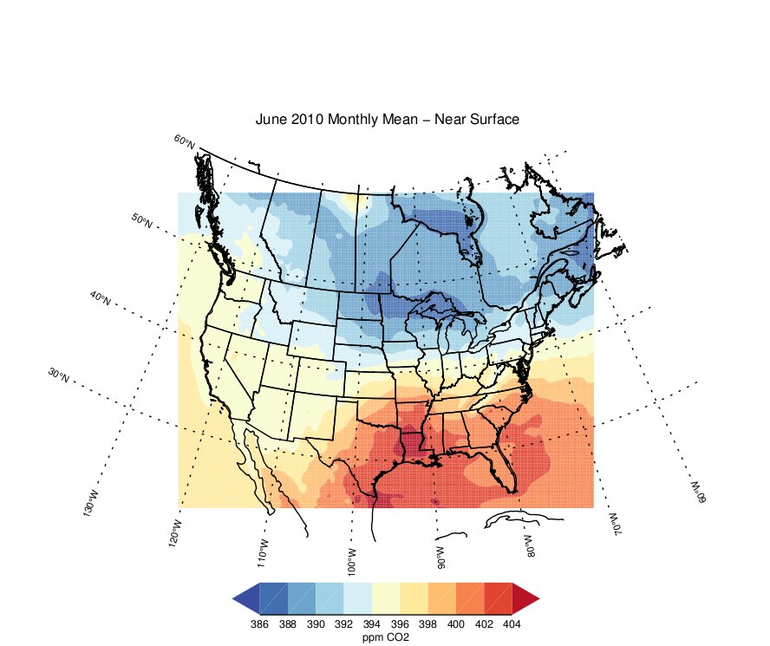
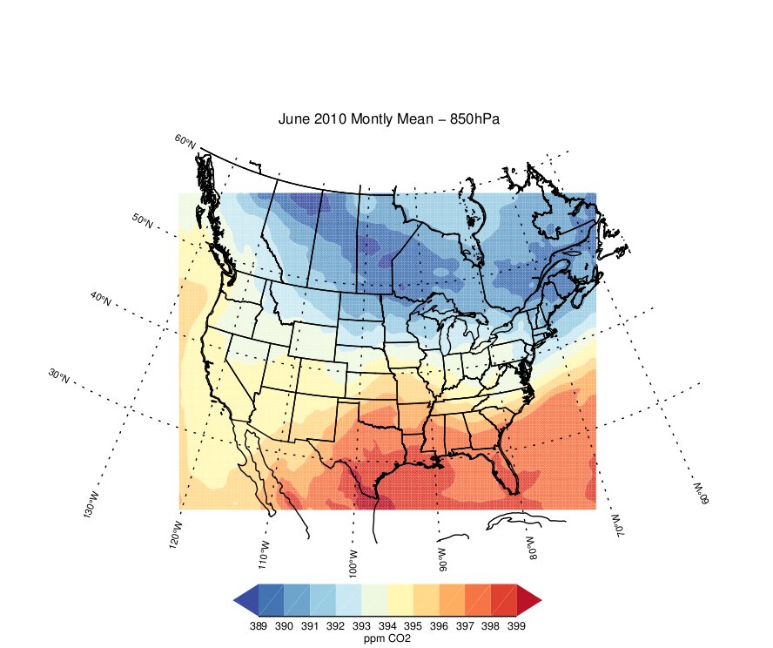
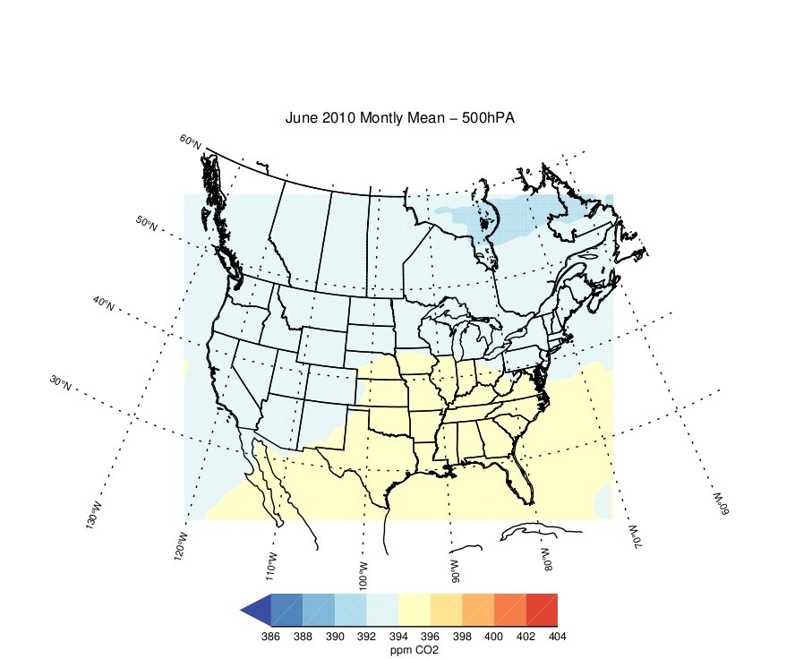
Coupling WRF and the NASA CMS-Flux system
WRF-CMS system (offline coupling)
WRF coupled to GEOS-Chem 4°x5° for surface fluxes and boundary conditions
- Bilinear interpolation at the boundaries (continuous flow with 6-hourly fields)
- Surface fluxes: CMS flux product components (fossil fuel, biogenic, ocean,...)
Simulated CO₂ atmospheric mixing ratios averaged over June 2010 using the WRF-CMS modeling system at 30km resolution near the surface (left panel), at 850hPa (middle panel), and at 500hPa (right panel)

Slide 9
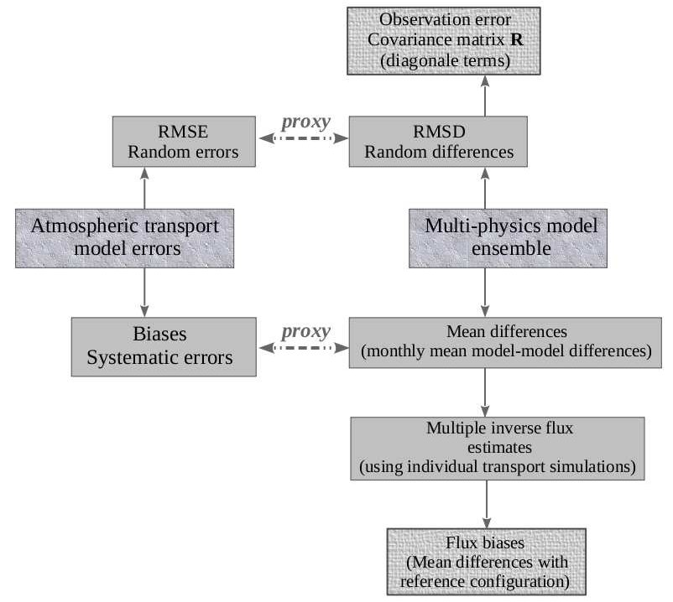
Sampling transport errors in WRF-CO2
from Lauvaux and Davis, 2014
Representation of transport errors in an inverse system using an ensemble approach to define the random and systematic errors

Slide 10
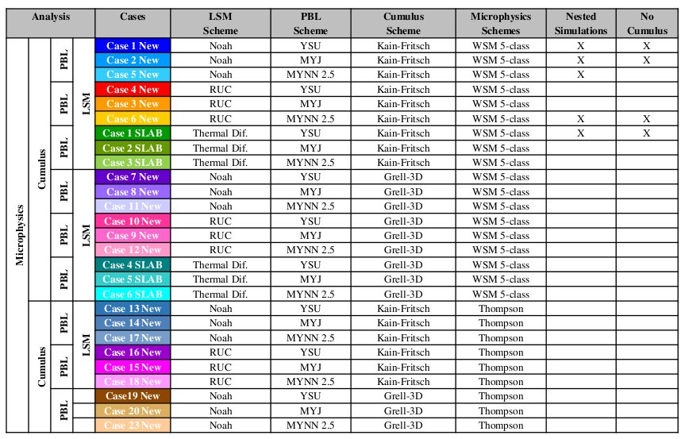
Ensemble-based statistics and transport errors
Two different approaches with ensemble methods to represent transport errors:
1. Generate the statistics with controlled perturbations,
2. Generate a large ensemble and sub-sample it (calibration),
OAX
LBF
MPX
DVN
Physics-based ensemble using 27 WRF model configurations of the PBL, land surface, and convection/microphysics schemes
Mean bias in the mean horizontal wind speed at 300m high using 00z radiosonde measurements for June 2008 at four sites across the US upper Midwest
Courtesy of Liza Diaz-Isaac

Slide 11
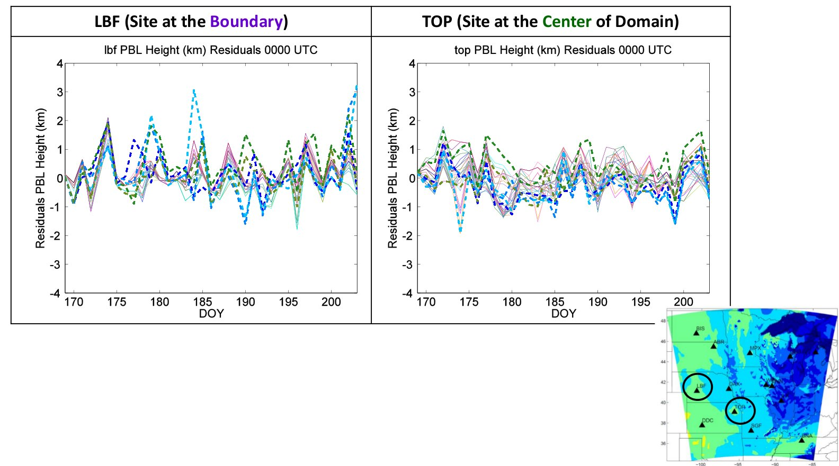
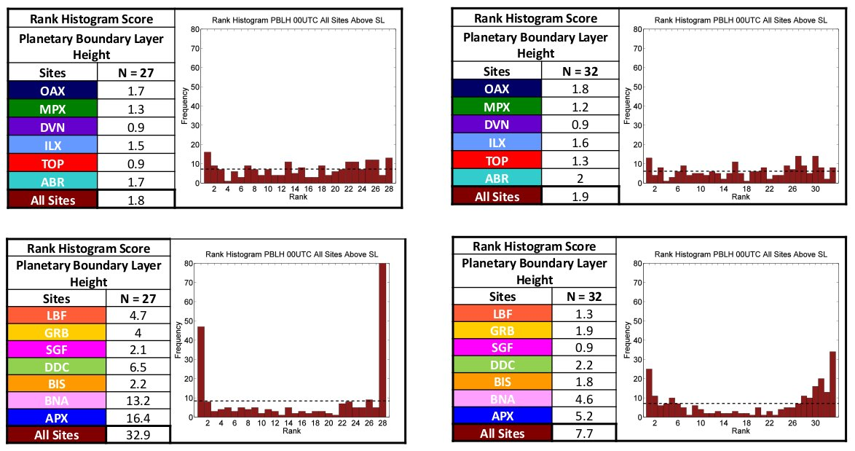
Example: Calibration of a large ensemble
Planetary boundary layer height time series (00z only) observed (in black) and simulated by WRF (27 colors) for June 2008, at two radiosonde sites
Rank histograms for the PBL depth using 13 radiosonde sites over 35 days (00z only) compared to WRF simulations at 10km resolution over the MCI domain
Courtesy of Liza Diaz-Isaac

Slide 12
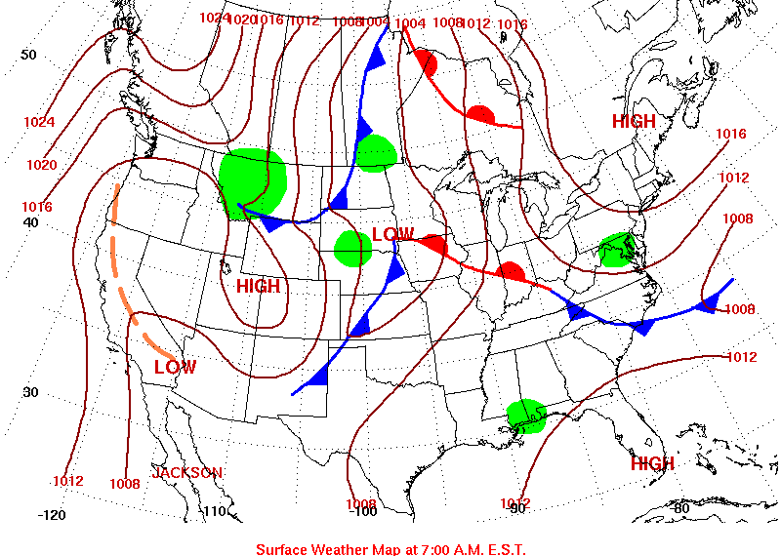
Synoptic event in GOSAT pseudo-data
Simulated GOSAT XCO2 data (in black), low altitude in-situ
CO2 (in green), Lower Troposphere in-situ CO2 (in orange), and Mid
Troposphere in-situ CO2 (in blue)
Corresponding weather map at 12 UTC of the same day
Low pressure center over Iowa, i.e. strong vertical mixing between PBL and Free Troposphere
Cloud/rain with no photosynthesis, so limited uptake and no convective PBL
CO2 concentrations are similar throughout the column

Slide 13
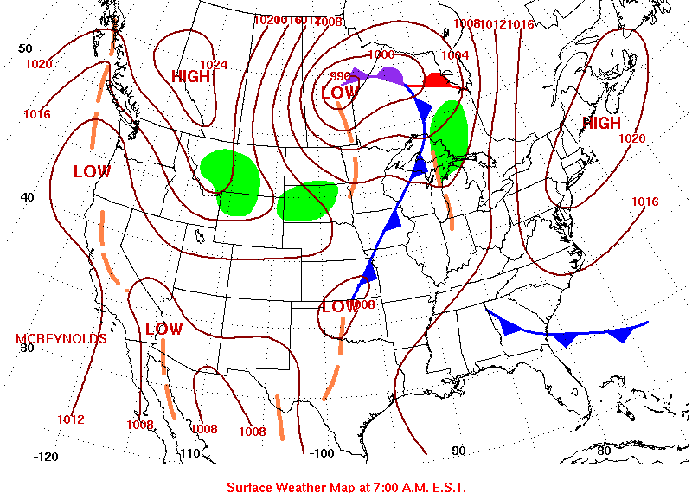
Synoptic event in GOSAT pseudo-data
Simulated GOSAT XCO2 data (in black), low altitude in-situ
CO2 (in green), Lower Troposphere in-situ CO2 (in orange), and Mid
Troposphere in-situ CO2 (in blue)
Corresponding weather map at 12 UTC of the same day
Low pressure center over Iowa, i.e. strong vertical mixing between PBL and Free Troposphere
Cloud/rain with no photosynthesis, so limited uptake and no convective PBL
CO2 concentrations are similar throughout the column

Slide 14
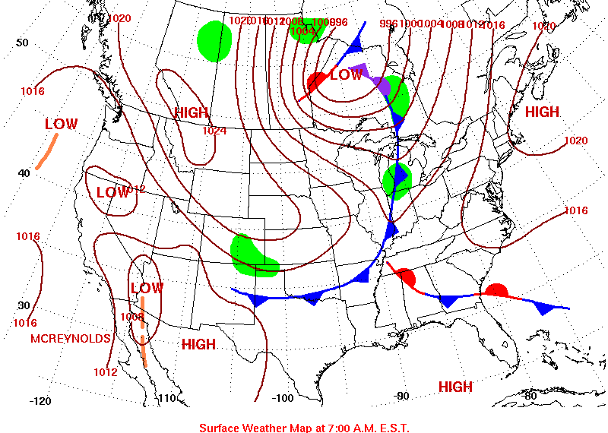
Synoptic event in GOSAT pseudo-data
Simulated GOSAT XCO2 data (in black), low altitude in-situ
CO2 (in green), Lower Troposphere in-situ CO2 (in orange), and Mid
Troposphere in-situ CO2 (in blue)
Corresponding weather map at 12 UTC of the same day
Aug 15th: Second front (cold) but no cloud, GPP starts, and wind direction shifts (corn area upwind)
Lower concentrations in the convective PBL

Slide 15
Conclusions and Perspectives
One year simulation at 30km resolution using WRF-CMS (2010)
Production of GOSAT simulated measurements
Evaluation/Comparison of GEOS-Chem and WRF-CMS using aircraft CO₂ profiles, meteorological measurements (radiosondes, surface stations), and in-situ CO₂ measurements
Perform inversions with NASA CMS-Flux inversion system using WRF-GOSAT data
Perform the ensemble of WRF simulations
Provide initial flux uncertainty assessment
including transport errors
Simulated XCO₂ averaged over June 2010 using the
WRF-CMS modeling system at 30km resolution

